Slide 1

Welcome to our
Annual Members’ Meeting
30th November 2022

Slide 2
Welcome and format
Steve McGuirk CBE DL QFSM
Chairman

Slide 3
Programme
Reviewing 2021-22 | Reviewing 2021-22
17:05 | Chief Executive’s report
17:15 | Quality People and operational performance
17:45 | Financial review and audit report
17:55 | Lead Governor’s report
Looking ahead 2022-23
18:05 | Strategy and look forward 2022-23
18:15 | Q&A session (including via online chat board)
18:30 | End

Slide 4
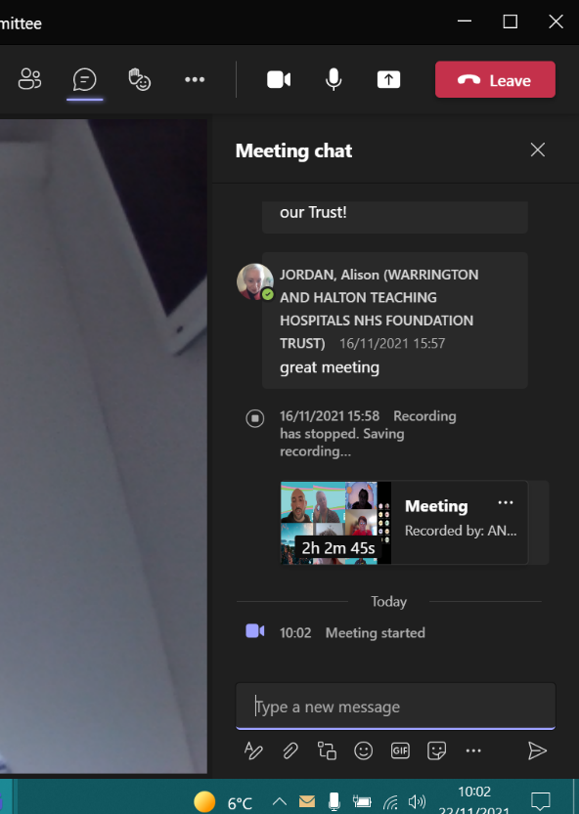
Questions
We’ll take questions at the end.
Online: If viewing online you can post questions in the chat box.
Audience: please raise your hand when asked to do so and we will come to you.

Slide 5
Reviewing 2021-22

Slide 6
Chief Executive’s report
Prof Simon Constable
Chief Executive

Slide 7
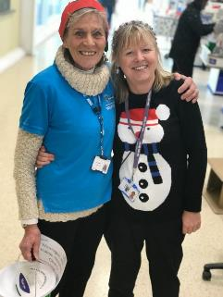
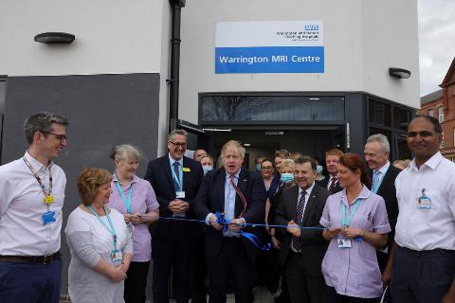
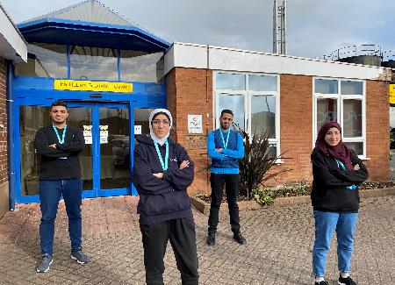



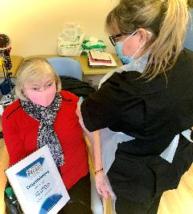
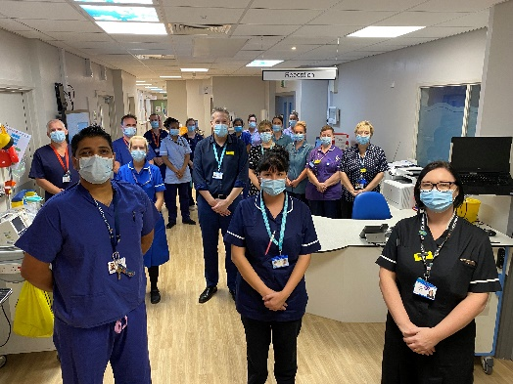
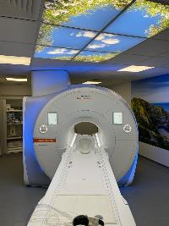
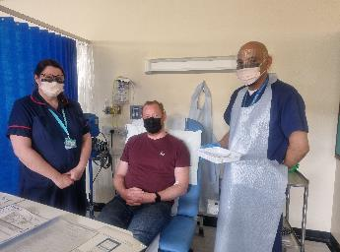


A year with our values at the forefront

Slide 8
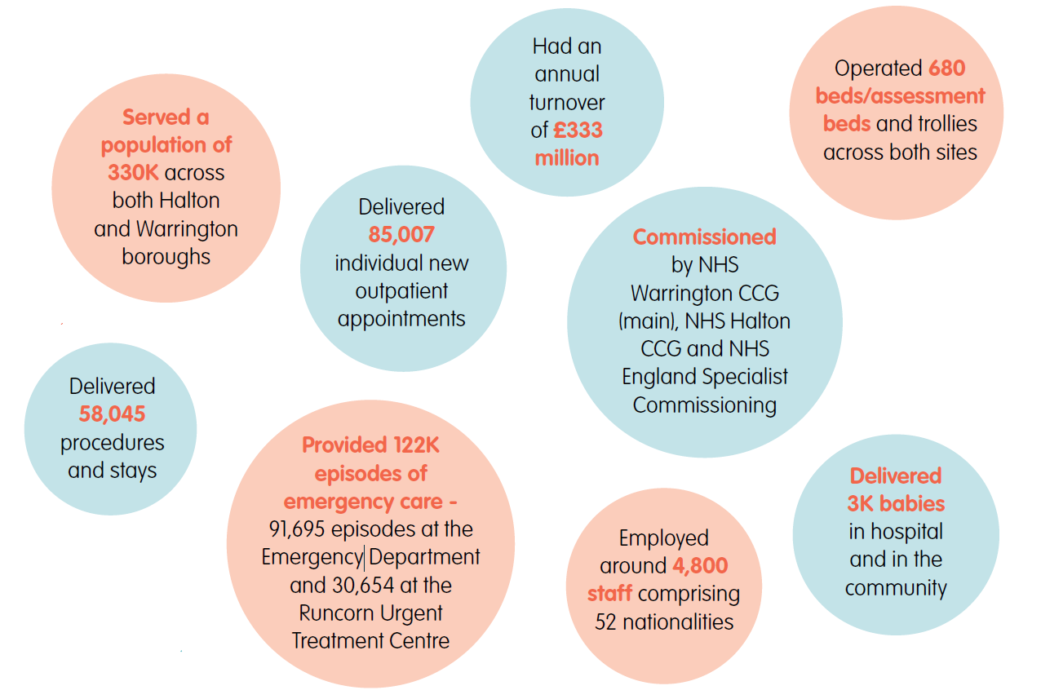
Key highlights 2021-22

Slide 9
A tale of two halves
We continued to live with COVID-19
Effective vaccines made a difference compared to 2020-21
We faced successive waves and new variants emerged, e.g. Omicron
We had higher than usual staff sickness absence due to COVID-19
We began restoration and recovery of our services
We started focusing on our backlog waiting lists
Demand remained high with pressures on both planned and unplanned care pathways
Urgent care attendances increased and escalation bed capacity remained open
Our 4,800 staff continued to rise to the challenge
We remained focused on our three objectives – quality, people and sustainability

Slide 10
Quality highlights
We invested over £5.5m in radiology services, including a new MRI Centre and scanner, plus a refurbished CT Scanning Suite
We re-opened Ward B18 as our new Acute Respiratory Unit
We started work on the two-storey, £6.3m Emergency Department expansion, which enabled the creation of a new Same Day Emergency Care unit
We improved our ambulance handover times, in partnership with the North West Ambulance Service
At Halton Hospital, we officially opened our new Breast Care Centre at the Captain Sir Tom Moore building, as well as the new Pre-Treatment Centre
Our Halton Clinical Research Unit, which opened in March 2021, became established, with up to 30 studies open to recruitment at any one time
We administered more than 70,000 doses of COVID-19 vaccines, of which more than 10,000 were boosters

Slide 11
People highlights
Looking after and developing our staff has always been a central tenet of our COVID-19 response
We continued to develop our leadership and enhance our health and wellbeing offer
We opened the Habab Clinical Education Centre in memory of our very own Jo Habab, lost to COVID-19 in May 2020
By the end of 2021, we had welcomed 90 overseas nurses, including refugees
Our four staff networks made real progress, embracing change and driving innovation
In the summer of 2021, we introduced the new ‘You Made a Difference’ awards, highlighting the amazing ways Team WHH go the extra mile to make a difference to people’s lives, day in and day out
Our Thank You Awards, held in December 2021, saw 326 applications, beating the previous year’s record of 215

Slide 12
Sustainability highlights
We delivered the financial position agreed with our regulator, recording an adjusted surplus position of £0.2m at the close of the year, which was slightly better than the breakeven plan we had previously agreed
COVID-19 expenditure was £7.8m
The final Capital spend for the year was £19m
We worked in partnership at a place level, as well as across the new Integrated Care System
We remained aware of the important role we play in our communities as an anchor institution, progressing plans to provide services in the heart of our communities and remaining committed to Net Zero Carbon and our Green Plan
We submitted a proposal to secure one of the last remaining eight places in the Government’s national new hospitals programme, and discussed these plans with then Prime Minister Boris Johnson when he visited Warrington Hospital

Slide 13
Quality, people and operational performance
Dr Paul Fitzsimmons
Executive Medical Director

Slide 14
Quality highlights
SHMI and HSMR in or below expected range
100% Medical Examiner scrutiny and community expansion
Ambulance handovers – continuous Quality Improvement
>90% NICE guidance compliance – evidence based care
Clinical pathway optimisation

Slide 15
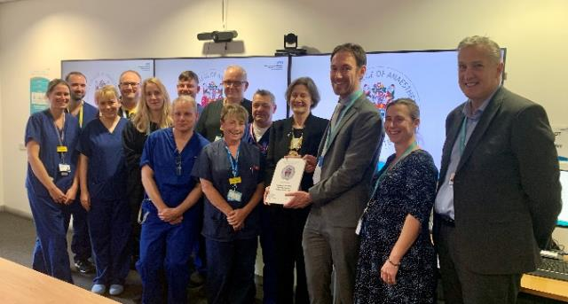
Quality – service accreditation – RCP JAG & RCOA ACSA
“Both sites operate to an equally exceptional standard and easily some of the highest standards we have seen in the UK.”
“The policies and processes adopted throughout the patient pathway are exceptional and there is an embedded culture of safety with team huddles, WHO safety checks and empowering nursing staff”
“In summary the service epitomises what a quality, safe endoscopy service with embedded standards is all about”

Slide 16
People - medical workforce
Implementing Medical Workforce Plan
12 New consultant appointments in year
Investment in Medical Staffing business cases
NEW study leave policy
NEW online appraisal and annual leave systems

Slide 17
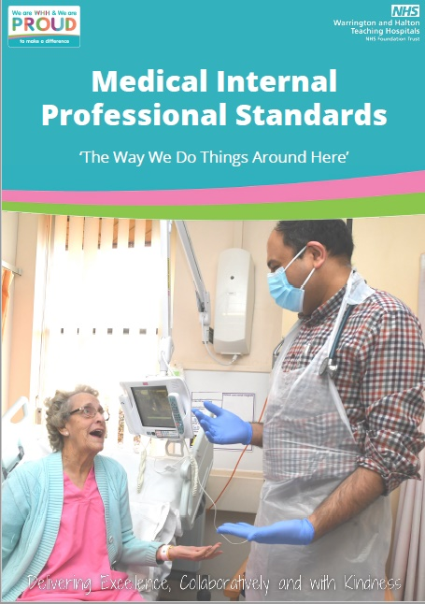
People - medical leadership and education
Medical Internal Profession Standards – ‘The Way we Do Things Around Here’
New AMD for Clinical Productivity and GIRFT
SAS Doctor leadership development
Two RCP Chief Registrars
Improved GMC National Trainee Survey results
Successful HEE Quality Team visits

Slide 18
Operational and digital highlights
Same Day Emergency Care - £6.3m ED expansion
GIRFT - Low risk pre-operative pathway
Virtual fracture clinic and e-trauma
Badgernet Maternity Electronic Patient Record
100% Digital inpatient prescribing including Critical Care

Slide 19
Quality, people and operational performance
Kimberley Salmon-Jamieson
Chief Nurse and Deputy Chief Executive

Slide 20






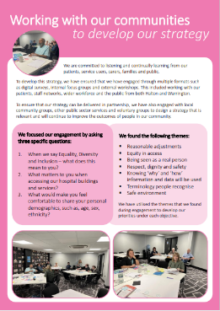
Patient Experience and Inclusion
Inpatient Survey Results 2021
3 questions scored ‘better than most Trusts’
Supporting patients at mealtimes
Consistent communication by staff members about patients care and treatment
WHH scored highest in the region for feedback received on the quality of care
Improvement required - waiting time for a bed on admission and support following discharge
WHH Volunteers
Growing our team and providing enhanced support for volunteers and greater flexibility for enhancing patient experience
Reduced recruitment processes by 4 weeks
Team of 343 Registered Volunteers with a variety of roles available
Patient Diversity Inclusion and Belonging Strategy
First Patient Diversity Including and Belonging Strategy developed with our community & focused work with Community Partners to improve patient experience
Carers Passport launched
Navajo Chartermark – a symbol of good practice and commitment to the LGBTQ+ community

Slide 21
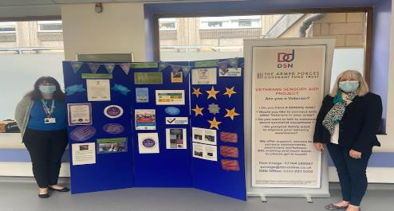
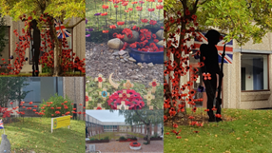
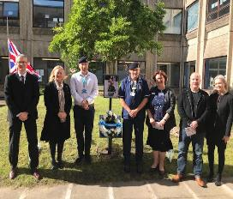


Commitment to our Armed Forces Community
Introduction of a Armed Forces Advocate Forces Role
Accredited as a Trust as an Armed Forces Friendly Hospital with Veteran Aware Accreditation
Engagement with veteran services locally and nationally
Identifying and recording our patients and staff within the military community to identify support needed
Reviewing and developing veteran patient pathways through the hospital

Slide 22

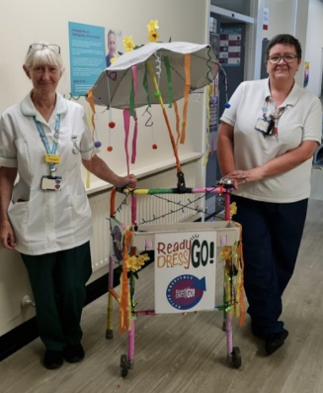
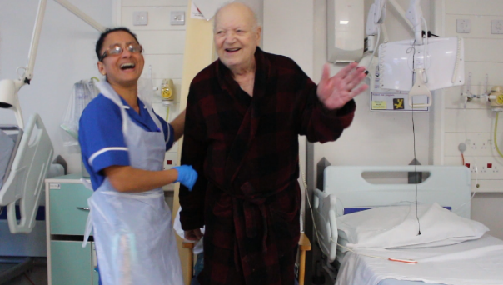
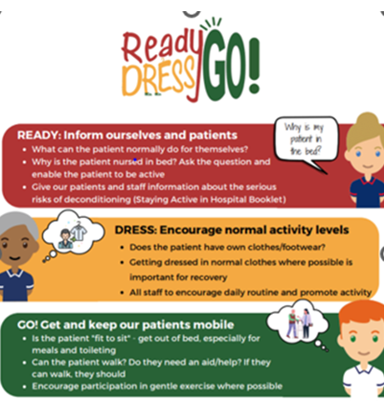
Active Hospital
A stay in hospital can make you feel weaker and everyday tasks can feel challenging and tiring.
Staying as active as possible whilst recovering from an illness in hospital is very important and helps with recovery.
How do our patients stay active in hospital:
Reconditioning Games
Ready Dress Go!
Readers Group
Tissue Viability & Falls Champions
Therapy ward based exercise classes
#Home4Noon
Fit2Sit MDT approach within the Emergency Department and on the wards
Hydration Campaigns

Slide 23
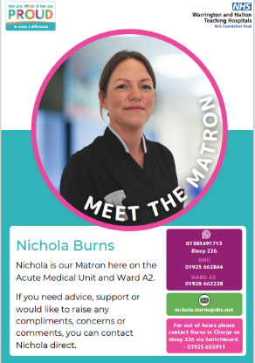

Complaints and Patient and Advice Liaison Service
176
43 days
11
11
Complaints received
Average time to respond to complaints
5.1 cm
5.1 cm
5.1 cm
Improved patient care at the time of concern
5.1 cm
2%
5.1 cm
5.1 cm
1237
11
3 days
PALS concerns received
1 cm
cm
11
5.1 cm
5.1cm
PALS concerns response time
5.1 cm
5.1 cm
PATIENT EXPERIENCE
To ensure learning and improvement
You said …. We did ….
LIVED EXPERIENCE
Shared by patients for learning from ward to board.
Meet the Matron initiative
Revised patient pathways with a focus on enhanced communication
Revised training packages for staff with direct insight from complaints
Digital patient stories recorded with patients and shared at meetings and training to encourage learning from complaints
Introduction of Experts by Experience initiative to involve patients in the solution

Slide 24


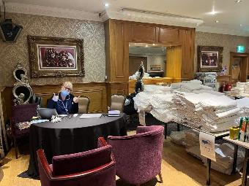
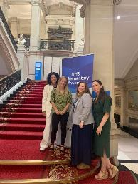

Maternity
In 2021/22 WHH Maternity Services supported families with the birth of 2596 babies
Implementation of the BadgerNet Electronic Patient Record System for all those choosing to receive care at WHH
Working closely with Maternity Voices partnership to ensure we listen to and learn from those who receive care at WHH
Commended by the Integrated Care Board for providing care and support to vulnerable families residing at the Fir Grove Hotel ensuring these families had access to safe maternity care
Implementation of the WHH continuity of care project into the Halton footprint with the establishment of Team Sunlight
Coming Soon:
Perinatal Mental Health pathway with introduction of a Specialist Midwife for Perinatal Mental Health
Review the environment within maternity triage
Working with Women’s Health and Maternity (WHaM) Programme to ensure best practice smoking cessation

Slide 25

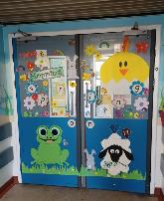
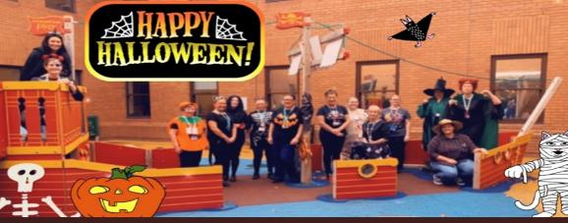
Children and Young People
Neonatal Unit
Lead for Neonatal Life Support & Accredited Provider
Family Integrated Care accreditation - Facilitating a partnership between parents and the staff, to promote parent-infant interactions and to build parent confidence.
Paediatrics
New Children’s and Young Peoples Outpatients Department designed with our children and young people
Development of a Long Terms Condition Team - support & education
Themed celebration days
Children decorate the entrance to the ward -welcoming and promotes a positive first impression
Coming soon
Expansion of outreach service
Enhance the AHP support for Neonates and paediatrics, including physiotherapy, SALT and psychology
Implement 7 day per week play therapy

Slide 26
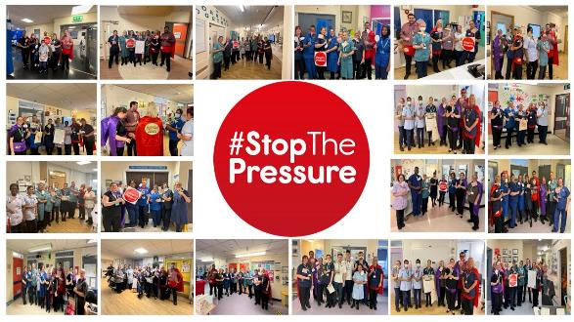

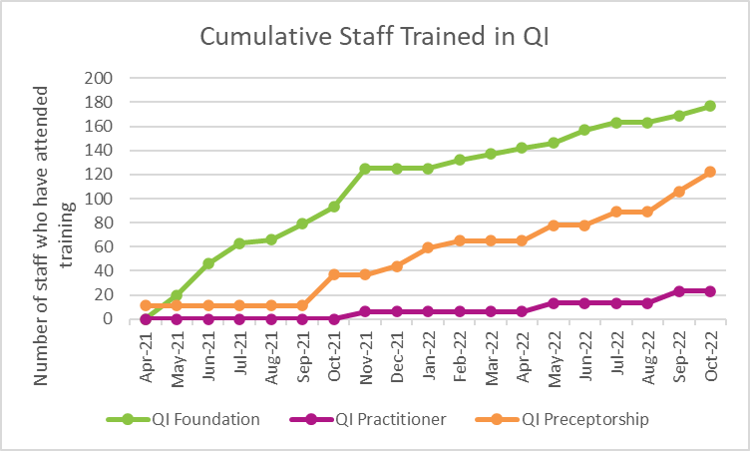

Quality Improvement
Improvement Collaborative: As the Falls & Pressure Ulcer collaborative continues, we are linking up ward champions to share learning across the organisation through the nominated falls and PU champions.
World Sepsis Day on 13th Sept that was facilitated by the Patient Safety Improvement Nurses and QI team building on awareness and understanding.
QI Capability Building: To continue to improve for our patients and each other - ongoing Quality Improvement training programmes are conducted by the Quality Academy across a variety of staff groups in the Trust.

Slide 27
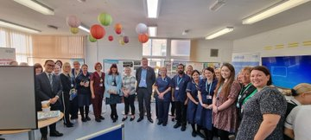
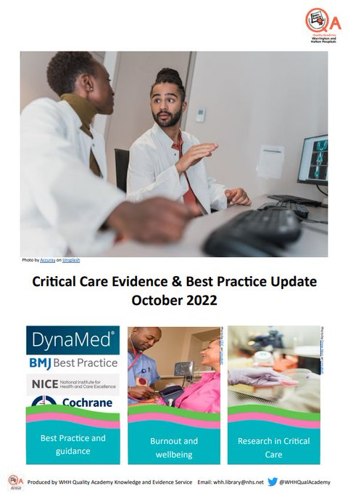
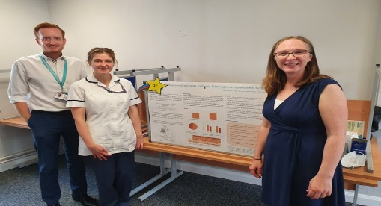
Quality Academy
Key QA Engagement Events:
Quality Academy Showcase- An annual celebration of improvement successes and learnings from excellence from various work streams across the Trust.
World Quality Day- The QA team held 2 Quality Café events at Warrington and Halton on the 9th and 10th November 2022. Thank you to everyone who came to share their ideas on how to best drive the quality agenda forward. Watch this space!
Stop the Pressure Day – On the 17th November, colleagues across the organisation came together to raise awareness of the Pressure Ulcers and how we can reduce the chances of patients acquiring one when in our care.
A total of 148 national and local clinical audits have been registered since 1st April aligned to the following quality priorities:
Patient safety – 75 audits
Patient experience – 4 audits
Clinical Effectiveness – 69 audits
Knowledge & Evidence Service (KES): Undertaking a campaign to increase staff usage of ClinicalSkills.Net - an online tool to support clinical skills teaching.
Pilot group & 60 members of staff have been trained to date.

Slide 28



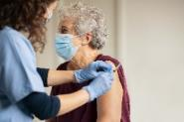


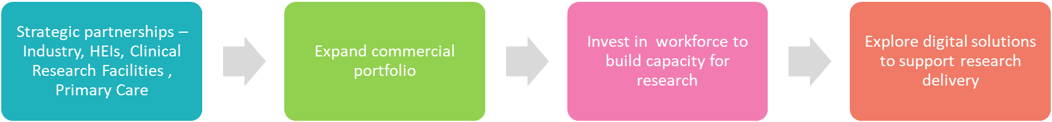
Research and Innovation
Success of Halton Clinical Trials Unit 2021-2022
391 patients recruited 3 Covid-19 vaccine studies £712,921 income 2022/23 “HARMONIE” 1st Paediatric RSV study Opened November 2022
Research at WHH 2022/23
51 active studies 791 recruits 31 active investigators 18 Specialities Get involved @ whh.pathwaytoresearch@nhs.net
Innovation Culture
Collaborating with Innovation experts from Alder Hey, Innovation Agency, LUFHT to develop a framework for Innovation
Key Achievements
“Excellence in Commercial Life Sciences Research” NWC Awards 2020 Shortlisted “Research Collaboration of the Year” in the 2022 NWC Awards. Best recruiter to Moderna study – 1st of 32 sites
What's Next

Slide 29






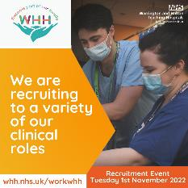
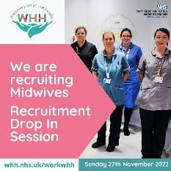
Clinical Workforce
Successful recruitment campaigns throughout the year have ensured we have welcomed:
35
Midwives
134
Nurses
228
HCSW’s
31 International nurses
59
AHP’s
Celebrating our workforce
Endoscopy Team have achieved JAG accreditation
Anaesthetic services successfully achieved Anaesthesia Clinical Services Accreditation (ACSA)
Warrington Maternity Team Regional winners in the 2022 NHS Parliamentary Awards in recognition of their Continuity of Carer Service
Ward of the month awards based on performance relating to patient safety and good practice
The next 12 months
Continue to welcome international nurses to our workforce with 56 joining us next year
Continue to work towards a zero vacancy rate for our Health Care Support Worker roles as part of the NHSE/I collaborative
Four Trust wide nurse recruitment events planned for the next 12 months

Slide 30
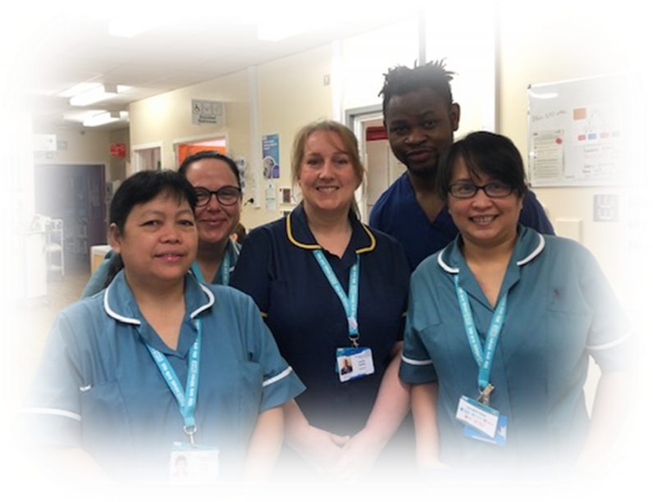

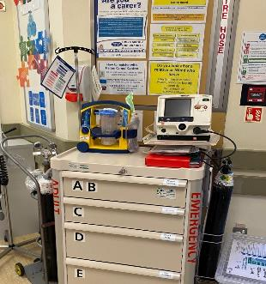
Clinical Education
Leading on a regional collaborative to increase placement capacity for student nurses
HCA Buddy Programme
Awarded 500k+ from bids for training equipment
Accredited as Resuscitation Council UK Newborn Life Support Training Centre
Standardisation of resuscitation trolleys across all site (Defib. renewal this year)
Expanding medical emergency team simulation to incorporate difficult conversations and breaking bad news
Relaunch of Acute Illness Management (AIMS) training

Slide 31
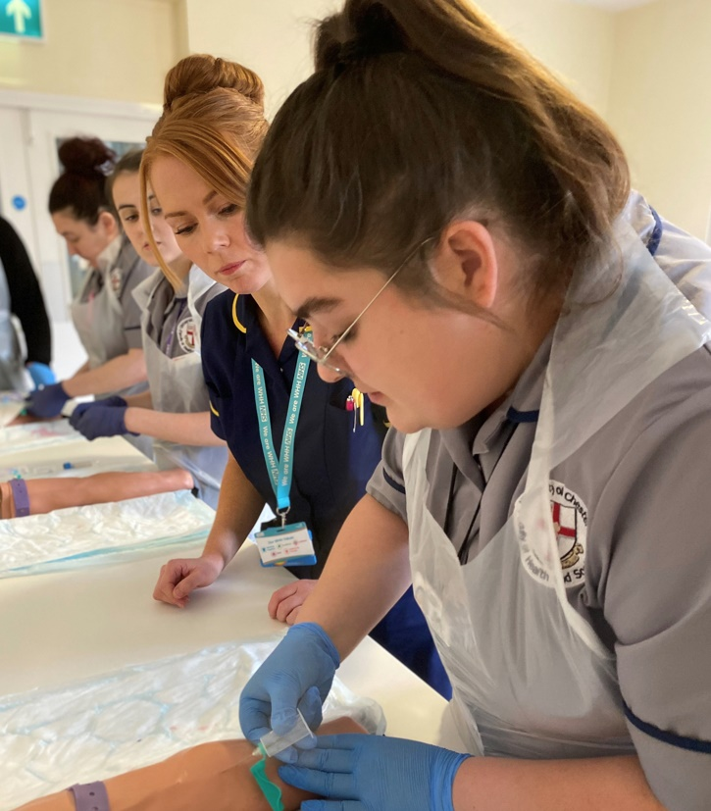
Clinical Education – What's Next
Going for Gold – Preceptorship
Launch of the STEPP programme – Support, Transition, Empower, Progression… to Preceptorship
Students will feel supported in developing their clinical and professional skills, ultimately providing safe and effective care to patients
Students will foster a sense of belonging towards the trust, encouraging them to apply for employment opportunities
Increase of the Trust’s reputation as the employer of choice across the student base and region
Students will be prepared for practice clinically and as leaders, improving quality of patient care

Slide 32
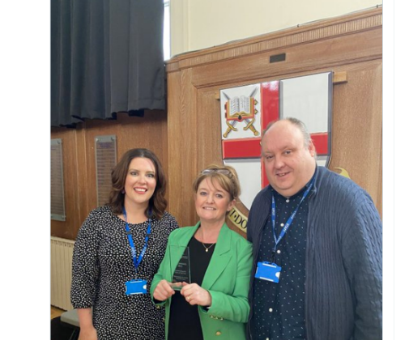
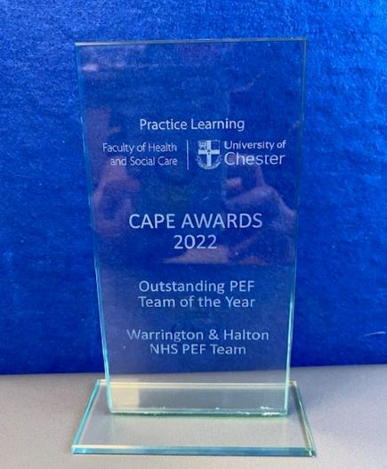
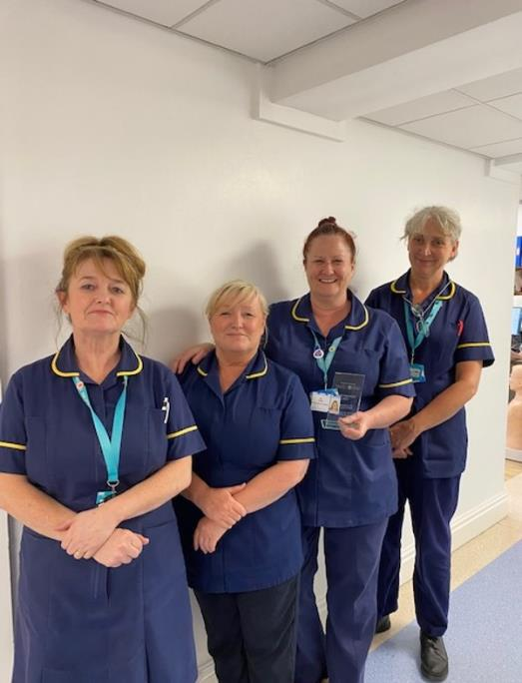
Winners…
Outstanding Team of the Year goes to –
WHH Practice Educators
Winner of the University of Chester CAPE (celebrating achievement and practice excellence awards)
Jonathan Jones - Excellence in Peer Support Award – Chester University

Slide 33
Quality, people and operational performance
Dan Moore
Chief Operating Officer

Slide 34
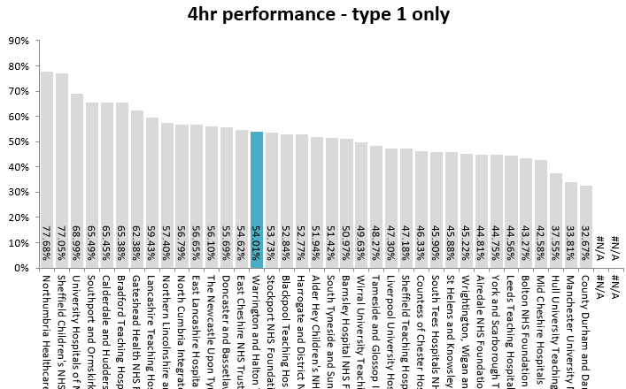
Urgent care
A challenging year for urgent care
Impacted by Covid19
Impacted by capacity outside of the hospital
Similar trend nationally
How we rank today

Slide 35
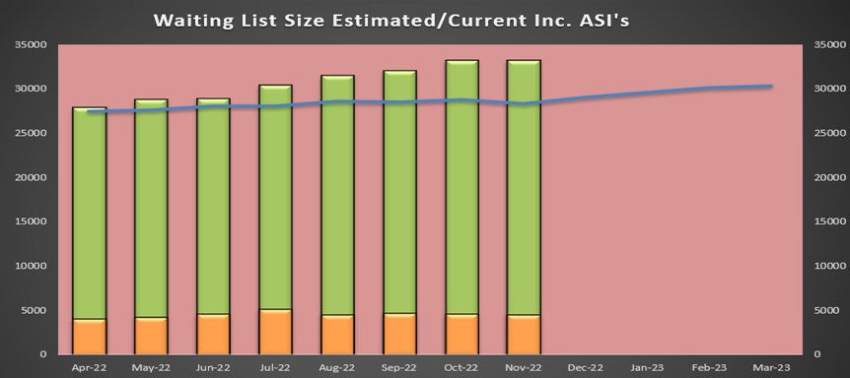
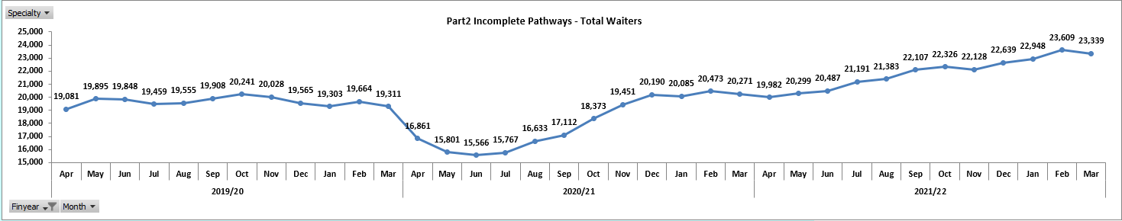
Restoration and recovery
Improvements in Referral to Treatment (RTT) - but a long way to go as we restore clinical services and bring down long waiting lists.
Reduction in patients >52 weeks and 104 weeks (no 104 week waiters since June 22)
The overall waiting list is growing as referrals increase (28,555 currently)
Aiming to have no patients waiting of 78 weeks on an elective waiting list by the end of March 2023

Slide 36
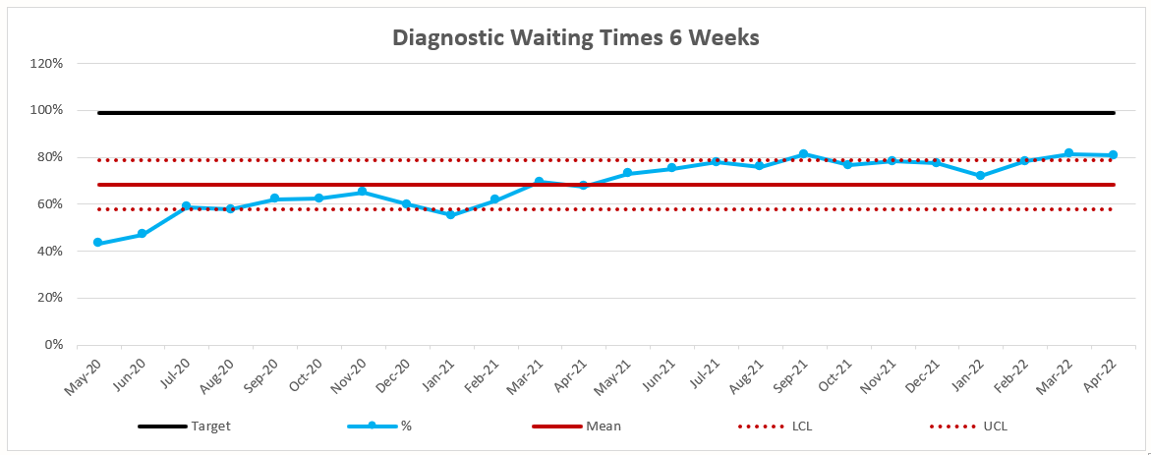
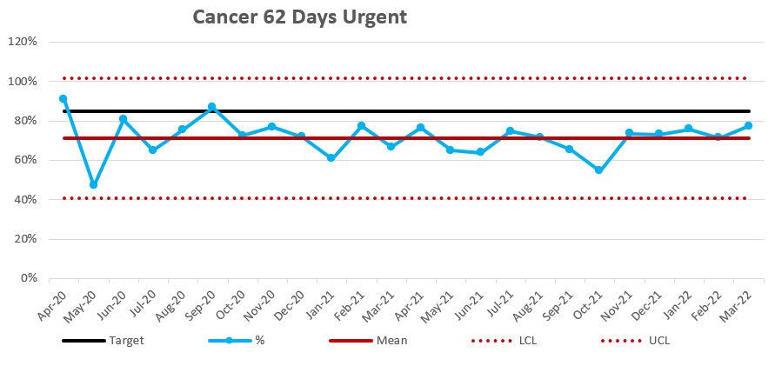
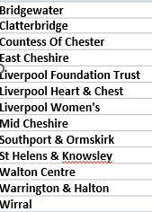

Restoration and recovery
Diagnostics
Good recovery in performance against the Diagnostic target of less than 1% of patients waiting more than 6 weeks for a test.
Strong recovery in Radiology,
Cardiorespiratory, particularly Echo and sleep studies tests remain challenged for capacity and increasing referrals
Cancer
Sustained improvements in Cancer waiting times as we restore services.
Reduction in patients waiting over 104 and 62 days for treatment
Sustained 31 day treatment standard
Slow recovery of the 62 day treatment standard, but in line with regional and national peers.
Continued increase (10-20%) of cancer referrals in some services.
No. of patients > 62 day
How we
are doing
Today…

Slide 37
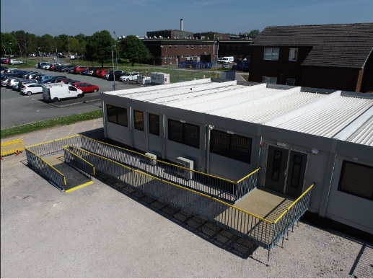
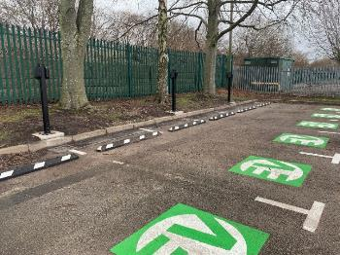
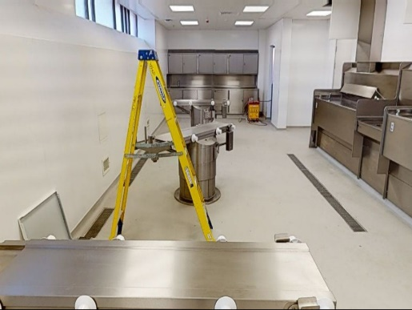
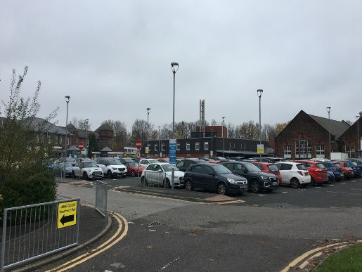
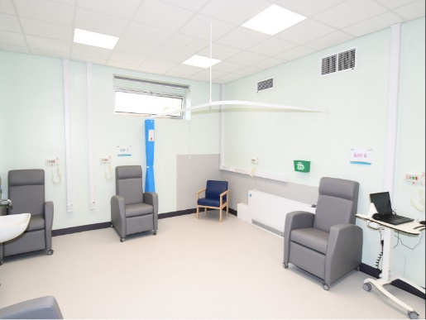
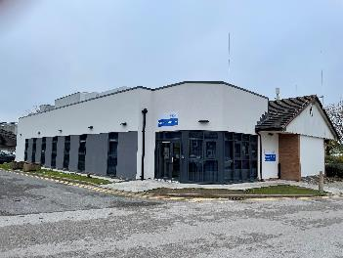
Estates capital
Another big year for Estate capital investments…. To name a few
B18 Respiratory Care - Aug 2021
Dental 3rd Chair –March 22
EV chargers both sites - March 22
Halton CT room – April 21
MRI Extension – November 21
Refurbishment of the mortuary – November 21

Slide 38
Quality, people and operational performance
Michelle Cloney
Chief People Officer

Slide 39

People priorities
Notes:
The people priorities achievements focus on three key areas:
Employment service and Human Resources
All About You – focus on our people
Equality, Diversity and Inclusion

Slide 40


People priorities
Employment Services and Human Resources
Within 21/22, had the highest number of new starters in WHHs history
In the past two years, 180 international Nurses have joined the organisation
Utilisation of apprenticeship levy to support development for new starters
40% of those retiring chose to return to the workplace, retaining their skills and experience
Focus on supporting attendance to keep staff happy, healthy and in work
Development of new policy and processes to support staff wellbeing
Engagement with national working group on agile working to support work-life balance
Focus on Staff Facilities provision to support staff wellbeing
Notes:
Employment Services and Human Resources

Slide 41





People priorities
All About You
How am I valued? | How am I included? | How am I supported? | How am I developed?
Review and refresh of WHH behaviours framework based on staff feedback | Continued to support Staff Networks (Building a Multi-Ethnic Environment, PROGRESS, Disability Awareness Network, Armed Forces and Veterans Staff Network) Staff survey clinics undertaken responding to the feedback from the national staff survey | Substantive investment into Occupational Health and Mental Wellbeing Hub teams with Counsellors and specialist OH Nurses Enhancing staff rest areas Partnership with The Brathay Trust for supportive programme for individuals most affected by COVID-19 Partnership continued with Rugby League Cares | Workforce recovery programme implemented across Planned and Unplanned care Increase in apprenticeship and widening participation opportunities Implementation of new line manager development programme Piloting new national talent management “Scope for Growth” tool
Notes:
All About You
All about you is the staff engagement, wellbeing, learning and OD brand which focuses on four areas which are levers to ensure that our people stay happy, motivated, healthy, and supported to develop:
1)How are staff are valued
2) How staff voice are heard and how staff are included
3) How staff are supported
4) How staff are developed
How am I valued?
Aligned to the refreshed organisational values of “kind” and “inclusive”, a kindness, civility and respect programme has been developed for deployment in 2022-23 to embed this approach across all departments and teams.
The organisation have reviewed the behaviours that are expected of the WHH workforce which has been implemented in supporting documentation for medical, clinical and non-clinical members of staff.
How am I included?
The organisation continues to support Staff Networks whose membership are growing with new titles and focus for each staff network.
Responding to staff feedback, a range of staff survey clinics have been implemented to enable teams to develop key actions to respond to their department staff survey results, therefore closing the feedback loop
How am I supported?
Substantive investment into OH and mental wellbeing team with permanent counselling team and additional OH specialist nurses to further support the workforce and respond to workforce need
Development of cross-staff group staff facilities task and finish group to further enhance staff rest areas across both Warrington and Halton sites
Focus on financial wellbeing and the development of resources to support financial wellbeing in the organisation, from the development of toy and school uniform swap shops to facilitating visits from local Credit Unions and Citizens Advice to support staff
Partnership working with the Brathay Trust to deliver intensive supportive programme for staff most affected by COVID-19 in partnership with the mental wellbeing hub.
Work in partnership with Rugby League Cares across both sites to support staff
How am I developed?
Responding to the need of enabling the workforce to continue to recover from the pandemic and sustained operational pressures, bespoke workforce programmes have been developed and delivered
Easing of social distancing and IPC restrictions have enabled the widening participation agenda to be implemented fully with an increase in apprenticeship and work experience opportunities. Inclusive approach has been the subject of a national conference where we were key note speakers
Pilot undertaken of new national talent management Scope for Growth tool to make the most out of development conversations with staff which supports retention.

Slide 42



People priorities
Achieved Navajo Charter Mark accreditation
Achieved the silver Employer Recognition Scheme from the Armed Forces Covenant
Working towards Disability Confident Level 3
Improvements in bullying and harassment metrics for WRES
Improvements in 5 metrics in WDES
Continued support from the organisation through Staff Network investment
Notes:
Equality, Diversity and Inclusion
The organisation in 2021-2022 achieved the following:
Navajo Charter Mark status – a reflection of our commitment to meeting the needs and providing the environment infrastructure to support our LGBTQ+ colleagues, patients and visitors
Silver Employer Recognition Scheme from the Armed Forces Covenant
Committed to and actively working towards Disability Confident Level 3
Improvements in WRES (Workforce Race Equality Standard) and WDES (Workforce Disability Equality Standard) scores

Slide 43
Financial review and audit report
Andrea McGee
Chief Finance Officer and Deputy Chief Executive

Slide 44
2021/22 outturn
The Trust had a control total of breakeven and achieved a surplus position of £0.2m
Agency expenditure was £12.6m
We spent £7.8m (£35m 2020/21) on COVID-19 revenue expenditure including staffing and equipment
We had a CIP target of £4.9m and achieved £5.4m
We invested in business cases and cost pressures c£14m including Recovery, K25, Respiratory, Clinical Research Unit, additional beds, Occupational Health support for staff
We invested in Capital expenditure of £19m including ED Plaza - Paediatrics, Critical Care, Breast screening, IT equipment, Medical Equipment, Xray and MRI
Cash balance at the end of the year was £44.7m (following funding at the end of 2020/21)
Audit opinion – unqualified accounts

Slide 45
Significant Revenue Investment 2021/22
Recurrent Revenue Business Cases | £000 | Non-Recurrent Revenue Business Cases | £000 | £000
Ward K25 | 2,837 | Diagnostic Recovery | 1,127 | 1,127
Respiratory Clinical Model | 1,054 | Ward C21 | 404 | 404
Lorenzo Update | 830 | Occupational Health Proposed Structure | 333 | 333
18 Additional Beds | 683 | Nursing Incentive | 318 | 318
Rheumatology | 398 | Halton Clinical Research Unit | 276 | 276
Halton Clinical Research Unit | 385 | Ward A7 Nursing Extension | 254 | 254
Occupational Health Proposed Structure | 277 | Use of Temporary Staffing B3/B4 | 253 | 253
Clinical Pharmacy Service to ED Department | 267 | IPC Nursing | 212 | 212
RTT Validation Team | 183 | Respiratory Clinical Model | 198 | 198
Acute Kidney Injury | 177 | Acute Kidney Injury | 178 | 178
ITU Non-Pay - Consumables & Drugs | 150 | Tier 3 Cardiology Cover | 136 | 136
Screening and Testing Arrangements | 137 | Winter / Ward B3 | 100 | 100
Tazocin | 120 | Staff Counsellor | 76 | 76
IPC Nursing | 106 | Student Nurses Incentive Scheme | 58 | 58
Diagnostic Recovery | 97 | Rheumatology | 54 | 54
Airseal intelligent Co2 insufflator and smoke evacuator | 97 | Health & Safety Staffing | 50 | 50
Coaguchek Consumables | 83 | Other | 745 | 745
Patient Flow | 81 | Total | 4,772 | 4,772
Procurement Support | 67
Health & Safety Staffing | 65
Radiology Porters | 48
Other | 823
Total | 9,273
Total Revenue Investment £14.045m
‘Other’ recurrent investment includes an Occupational Health Trainee nurse, investment in Equality, Diversity and Inclusion and an Undergraduate Skills Lab
‘Other’ non-recurrent investment includes Critical Care on call, Procurement support and an Undergraduate Skills Lab

Slide 46
Investment | £000
Core Programme | 7,853
ED Plaza | 3,329
Breast Unit Relocation | 1,034
Diagnostics Digital Capability Programme (DDCP) | 993
MRI Estates | 897
ICU / Ward B18 | 816
Paediatrics (Children’s Outpatients) | 810
Urology (Estates) | 801
Cardiac Catheterisation Suite | 656
Shopping City | 407
Modular Building | 291
NHSX Cyber Network | 278
Patient Flow (Targeted Investment Fund Digital) | 263
Digital Maternity UTF (Unified Tech Fund) | 260
Radiology - Fluoroscopy Room | 249
Devices Refresh Agile Working - NHSX Frontline Digitalisation Bids - Enabling Digital Infrastructure | 212
Total | 19,149
Significant Capital Investment 2021/22

Slide 47
What is 2022/23 looking like?
Block Contract continues
The first half of the year off plan by £0.2m with a deficit of £7.6m and working towards a £6.1m deficit plan
The first half of the year CIP target achieved £5.2m, however finding recurrent efficiency schemes remains a challenge. The Trust has made a small investment in Clinical productivity and efficiency roles to improve this.
Paying 93% of suppliers within 30 days
Focus on run rates and review of all expenditure over the last 2 years including any on going COVID expenditure
Escalation beds and No Criteria to Reside patients continuing to put pressure on the financial position, activity targets and staff

Slide 48
Additional capital
Community Diagnostic Centre (£10.5m over 3 years)
Help create additional capacity for diagnostic services across the country to help tackle increased waiting times caused by the pandemic
Phase 1 – using vacant space to enable additional activity
Halton Elective Centre (£9.2m over 3 years)
Support to tackle the COVID-19 backlog of elective care
Additional theatre, new day case unit, additional Endoscopy room and upgraded ward

Slide 49

Finance team successes
Towards Excellence Level 3 Finance Accreditation
Louisa Taylor won HFMA North West - Outstanding Individual 2022
Shortlisted for 3 National HFMA awards (outcome December)
Clinician of the Year Award - Anne Robinson, Deputy Medical Director
Costing Award – Costing Finance Team
Diversity and Inclusion Award – Finance Equality, Inclusion and Diversity working group

Slide 50
Lead Governor’s report
Norman Holding
Public Governor

Slide 51
Elections Sept-Nov 2021
These elections were the first with the revised constituencies. Public Governor constituencies reduced from 16 to five. Total Public Governors increased from 16 to 19
Warrington North 5 Governors 2 Vacancies 2 Governors elected
Warrington South 5 Governors 1 Vacancy 1 Governor elected
Runcorn 4 Governors 3 Vacancies 3 Governors elected
Widnes 4 Governors 3 Vacancies 3 Vacancies
Rest of England 1 Governor No Vacancy
Staff Governors 5 Governors 1 Vacancy 1 Governor elected
Partner Governors 6 Governors

Slide 52
The work of the Council of Governors
Governors observed key Board Committees: Trust Board (Public & Private Sessions), Audit Committee, Strategic People Committee, Finance & Sustainability Committee, Quality Assurance Committee and Clinical Recovery Oversight Committee & Charitable Funds Committee
The Governors’ Nominations and Remunerations Committee met several times in year to:
Appoint the Trust’s auditors
Agree process to appoint non-executive directors
Approve the Chairman’s appraisal
Appoint new non-executive directors

Slide 53
The work of the Council of Governors (2)
Governors participated in Governor and Trust group meetings, which allows them to be involved and put forward patient / public views:
Governor Engagement Group
Governor Working Group
Patient Experience Committee
New Hospitals Group
Transport Group
Patient Equality, Diversity & Inclusion
Governor Constituency Meetings
Activities within Constituencies

Slide 54
The work of the Council of Governors (3)
The governor working group has:
Reviewed the constitution
Discussed areas to enhance the governor role
Discussed better ways of engaging members and the general public
Governor training:
New and continuing governor attended a governor induction day
Governors have participated in a number of workshops ran by NHS Providers
Governors attended the NHS Providers Annual Governors Conference

Slide 55
Why we do our role
To represent the interests of the members of the Trust and the interests of the general public of Warrington and Halton
To feedback information about the Trust, its vision and its performance to members, public and stakeholder organisations
To effectively fulfil the role of governor by holding the non-executive directors individually and collectively to account
Our visits allow a chance to get closer to the ‘coalface’ rather than in the board room
To identify and report any areas we see in need of improvement
Patients and staff get to meet and speak with their governors
To engage with and feed back the views of the members and the general public.
Because we enjoy doing it!

Slide 56
Looking ahead 2022-23

Slide 57
Strategy and look forward 2022-23
Lucy Gardner
Director of Strategy and Partnerships

Slide 58

We will refresh our Trust strategy, continuing to prioritise Quality, People and Sustainability

Slide 59



We will always put our patients first, delivering safe and effective care and an excellent patient experience
Opened July 2022
Opened September 2022
Same Day Emergency Care unit
Paediatric Outpatients

Slide 60


We will always put our patients first, delivering safe and effective care and an excellent patient experience
Opened November 2022
Due Spring 2023
Urology Investigations Unit
Breast screening consolidation at Bath Street

Slide 61


We will always put our patients first, delivering safe and effective care and an excellent patient experience
Due 2023
Due 2023
Emergency Department Minors development
CT scanner in Emergency Department

Slide 62


We will always put our patients first, delivering safe and effective care and an excellent patient experience
Community Diagnostic Centre (Phase 1)
Due 2023
Targeted Investment Fund to expand elective capacity
Due 2024

Slide 63

We will always put our patients first, delivering safe and effective care and an excellent patient experience

Slide 64

We will be the best place to work, with a diverse and engaged workforce that is fit for now and the future
Opened September 2022
Implementation of refreshed WHH People and EDI Strategies
Celebration of Festival of Light and Black History Month (Staff Networks)
Continuation of Growing As A Leader programme to develop our staff
Implementation of Winter Well campaign and approach
Targeted recruitment campaigns for ED, Maternity and Pharmacy
Health and Social Care Academy

Slide 65


We will work in partnership with others to achieve social and economic wellbeing in our communities
Opened November 2022
Due Winter 2023
Halton Health Hub
Warrington Living Well Hub

Slide 66


We will work in partnership with others to achieve social and economic wellbeing in our communities
Due Autumn 2024
Planning
Runcorn Health and Education Hub
New Hospitals

Slide 67
Q&A session

Slide 68
Thank you for joining us

